Slide 1
Digital Electronics
Ziaullah Khan

Slide 2
Objectives
Number Systems
Decimal
Binary
Octal
Hexadecimal
Logic Gates
AND
OR
NOT
XOR
Microprocessor
8085
8086

Slide 3
Number System
Decimal | Binary | Hexadecimal | Octal
0 | 0000 | 0 | 0
1 | 0001 | 1 | 1
2 | 0010 | 2 | 2
3 | 0011 | 3 | 3
4 | 0100 | 4 | 4
5 | 0101 | 5 | 5
6 | 0110 | 6 | 6
7 | 0111 | 7 | 7
8 | 1000 | 8 | 10
9 | 1001 | 9 | 11
10 | 1010 | A | 12
11 | 1011 | B | 13
12 | 1100 | C | 14
13 | 1101 | D | 15
14 | 1110 | E | 16
15 | 1111 | F | 17

Slide 4
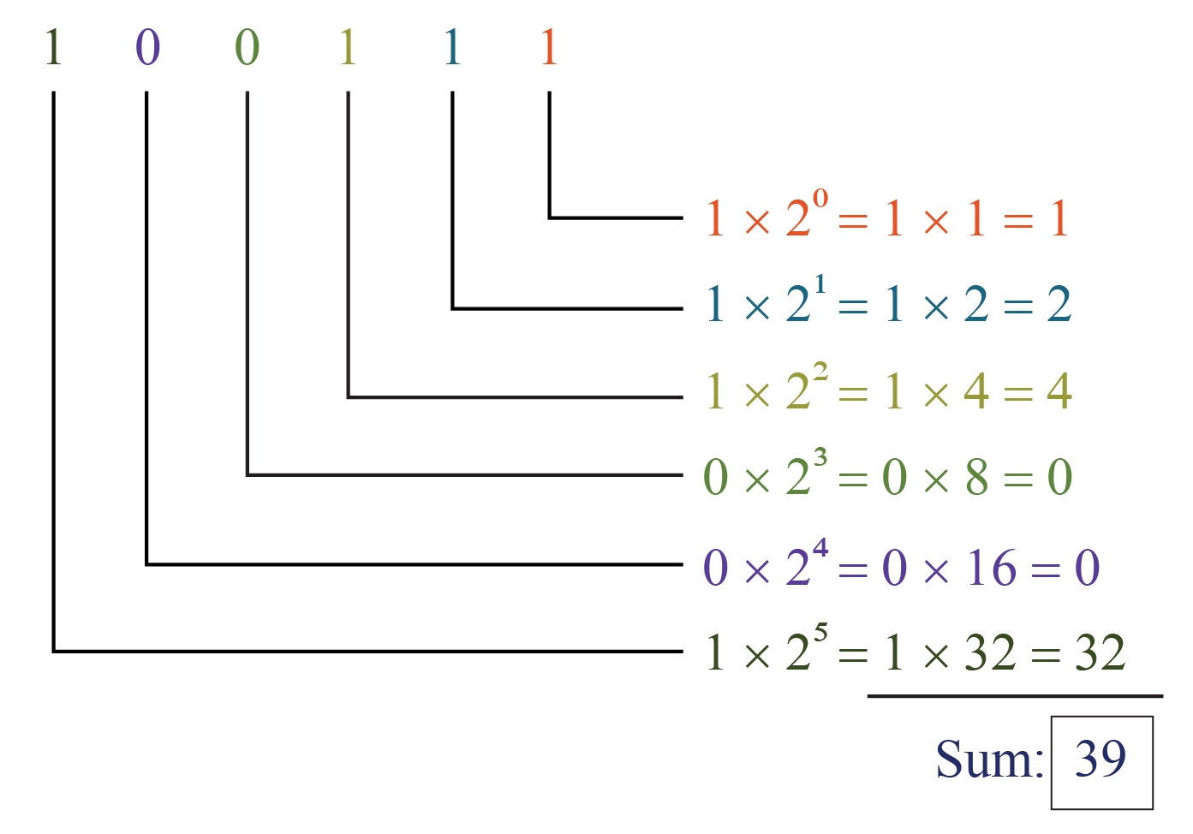
Conversion

Slide 5
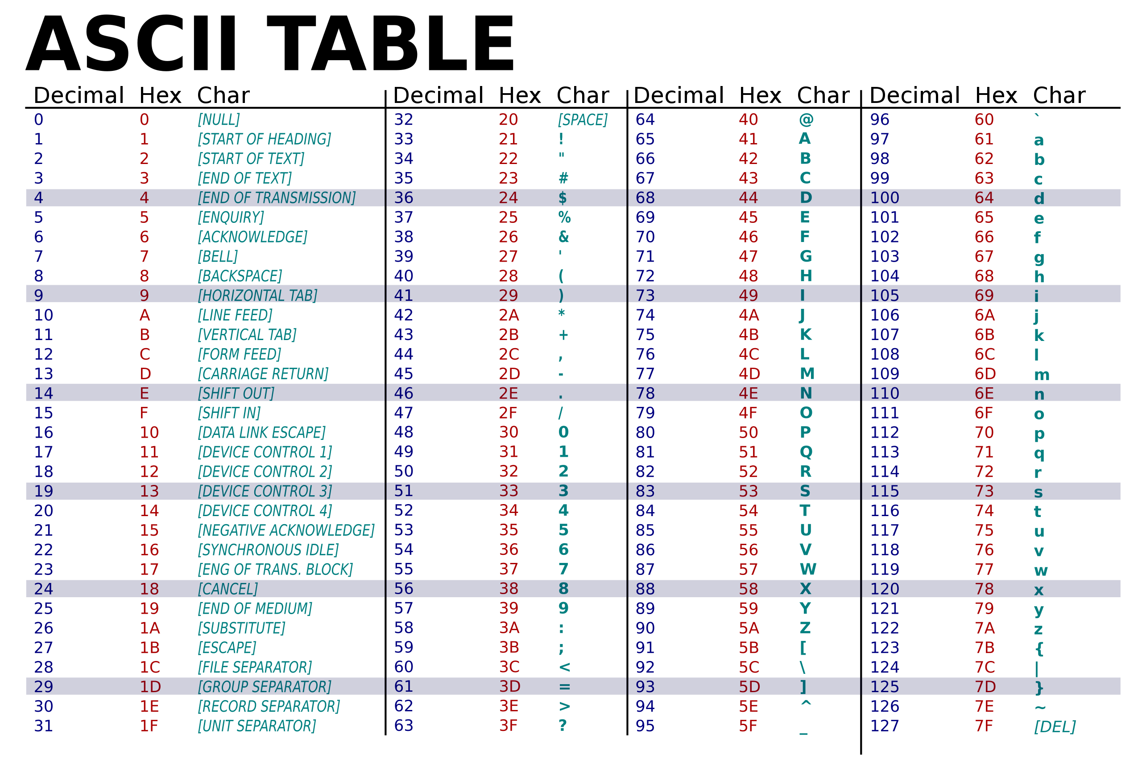

Slide 6
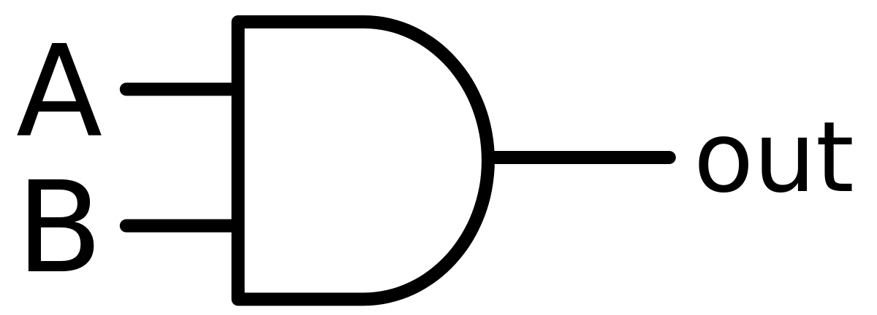
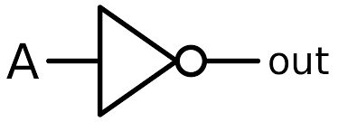
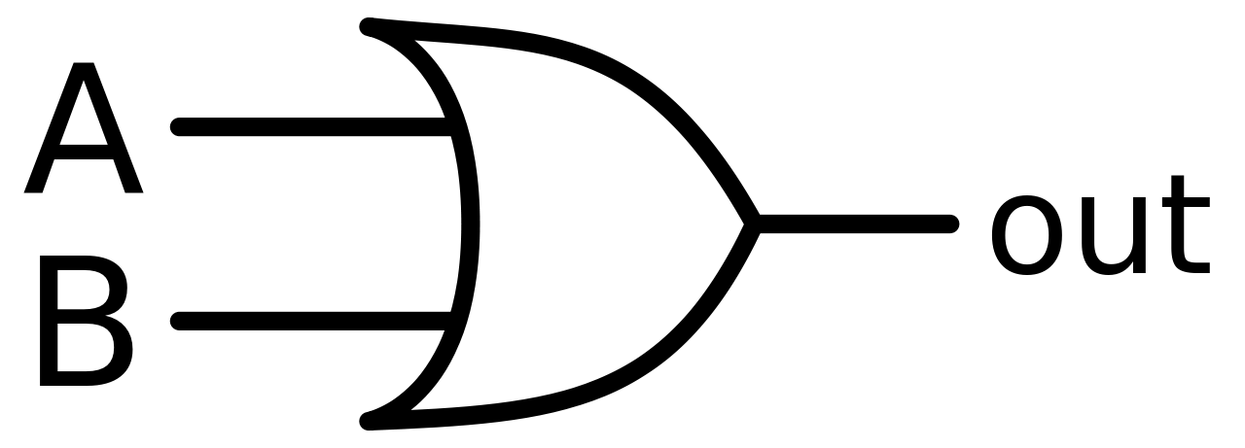

Binary Operations
NOT
AND
A | Output
0 | 1
1 | 0
A | B | Output
0 | 0 | 0
0 | 1 | 0
1 | 0 | 0
1 | 1 | 1
OR
XOR
A | B | Output
0 | 0 | 0
0 | 1 | 1
1 | 0 | 1
1 | 1 | 1
A | B | Output
0 | 0 | 0
0 | 1 | 1
1 | 0 | 1
1 | 1 | 0

Slide 7
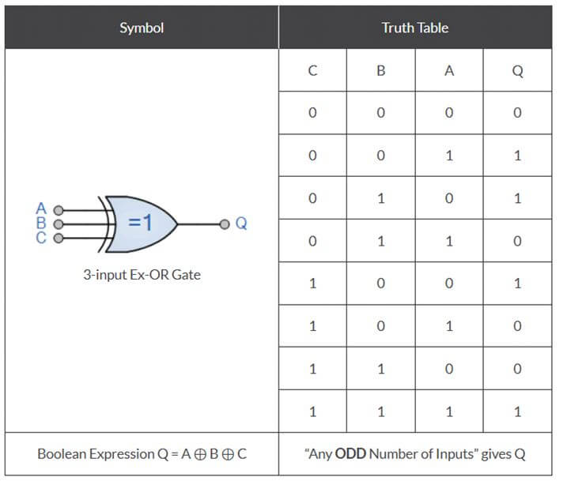
3 input XOR

Slide 8
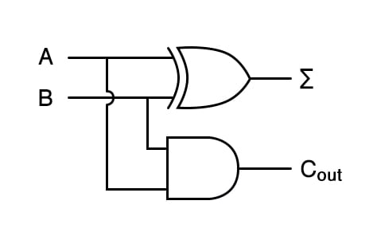
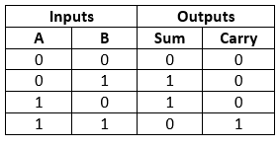
Binary Adder

Slide 9
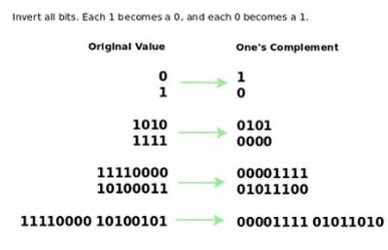
1s Complement

Slide 10
2s Complement

Slide 11
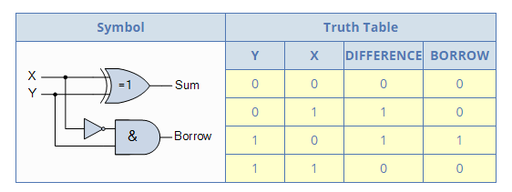
Binary Subtractor

